Slide 1
Binary LMS File Interpretation
Katherine Gresback: Team Leader
David Orona: Team Communications Leader
Jonathan Yeoh: Key Concept Holder
Eric Riedl: Webmaster
Faculty Advisor: Dr. Zambreno
Client: Honeywell

Slide 2
Important Definitions
LMS
Liege Measurement System
LDSF
Large data streaming file
SCADA
Supervisory control and data acquisition (program for process control)
MEX
Matlab executable

Slide 3
The project
The summary of our project discusses creating a Matlab function that is capable of directly reading input data from a SCADA system used by our client.
The current process used by Honeywell is very inefficient, taking between forty-five minutes and an hour due to the high sampling rate of the input data.

Slide 4
Our plan
In order to allow Matlab to read the input data…
Would contain all of the necessary functions and information necessary to efficiently read and convert the data into format readable by Matlab.

Slide 5
Functional Decomposition
Purpose of the Project
To create faster LMS processing of Honeywell procedure
Specifications in Achieving This
Create a reusable function
Utilize existing Honeywell technologies - the deliverable from the client
Put processing reliance on RAM versus mass storage

Slide 6
Technologies Utilized
This is strictly a PROGRAMMING assignment
No external devices required/feasible
Microsoft Visual Studio
C++
Interacts with Matlab in a give/take relationship

Slide 7
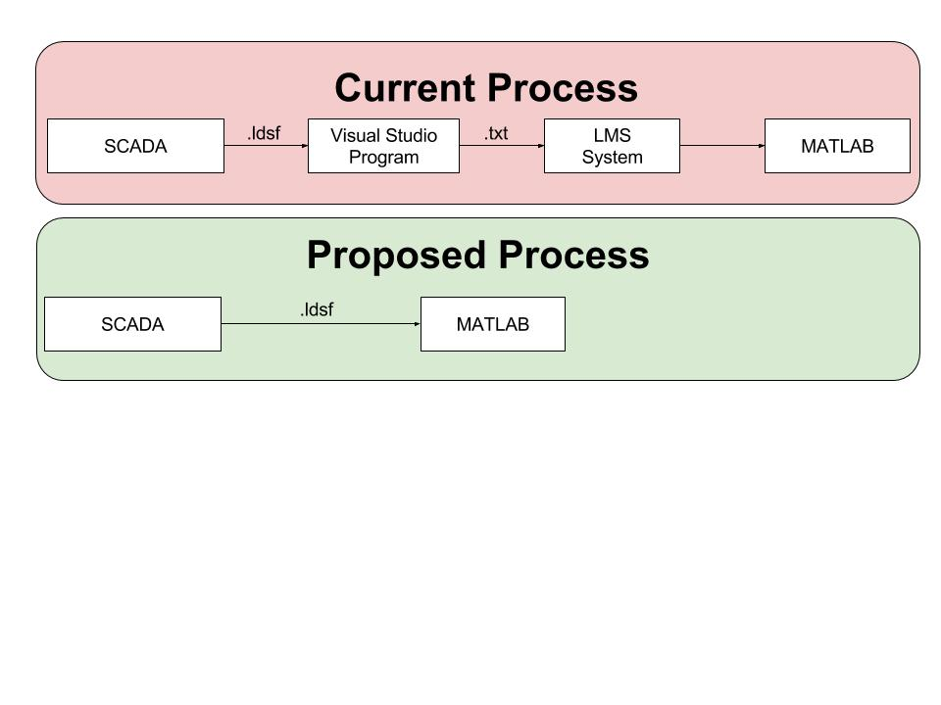
Detailed Design

Slide 8
Project Building - Introduction
In order to modify a project, it is important to have one BUILD
Show changes
To start, the team limited the existing output to a 100x100 array
Short output and easy-to-compare as opposed to current model
me.txt = current model
However, the changes were NOT applied when attempting rebuild
This indicated build errors
Limited Output Attempt

Slide 9
Project Building - Library Establishment
Analyzing the provided material, a library was found to be missing
Constructed a new library and linked it up to the existing .vcxprog
Library Definement in the Project Properties Window

Slide 10
Project Building - Current Situation
Led to error established earlier
With this error, no “progression” could continue due to improper build
ex. Fixed 100x100 array was not established
ec. Changing “me.txt” to “met.txt” yielded no result
Current Build Errors
Proof of Failure to Build

Slide 11
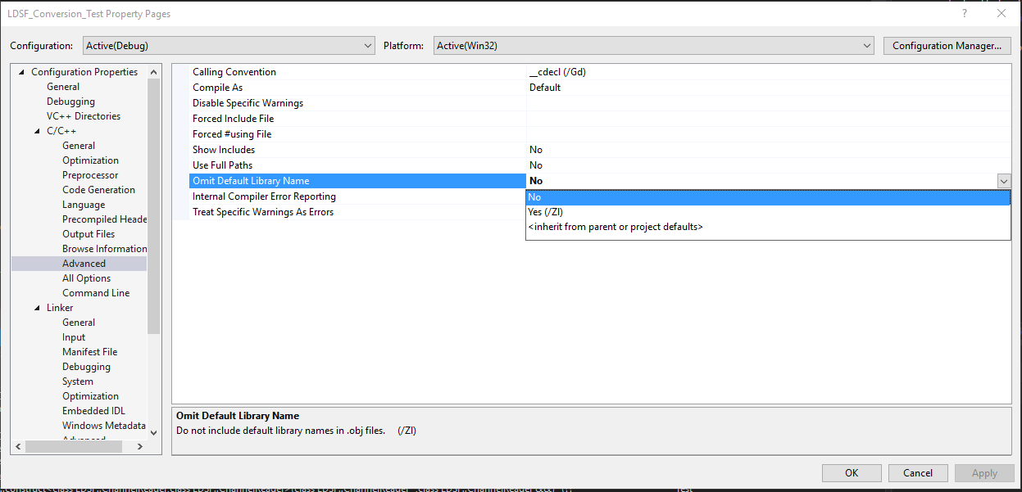
Project Building - Attempts at Rectification
David worked to define these “missing” libraries
Major error
LNK2001
Unresolved external symbol
Caused by “upgrading a managed library”
“Fixed” through removing /ZI property
Removing Property

Slide 12
Project Building - Results
More errors...

Slide 13
Generating a mex function
Notes:
Testing

Slide 14
Why generate Matlab Mex Function in Microsoft Visual Studio?
Advantages :
Better debugging process because Visual Studio give a more detailed information about the error such as identifier, directory, linker and etc.
Mex function generated in one-click (build solution)
Notes:
Testing

Slide 15
Step 1: Property Changes in Visual Studio
Make sure the platform is set to either 32-bit or 64-bit based on your MATLAB’s bit version (run ‘computer’ or ‘mexext’ command in MATLAB)
Set Target Extension to ‘.mexw64’
Set Configuration Type to Dynamic Library (.dll)
Go to VC++ Directories, then Include Directories, then add ‘$(MATLABROOT)\extern\include’
Go to Linker, then General, then in Additional Library Directories,
add $(MATLABROOT)\extern\lib\win64\microsoft and $(MATLABROOT)\extern\lib\win64\mingw64
Go to Linker, then Input, in Additional Dependencies, add ‘libmx.lib’, ‘libmex.lib’ and ‘libmat.lib’
Notes:
Testing

Slide 16
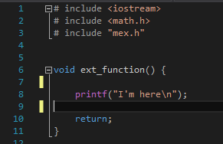
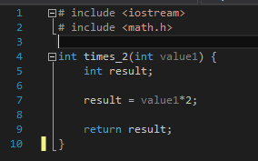
Step 2: Construct C++ Codes
Print “I’m here”
Return the double of the input integer
Notes:
Testing

Slide 17
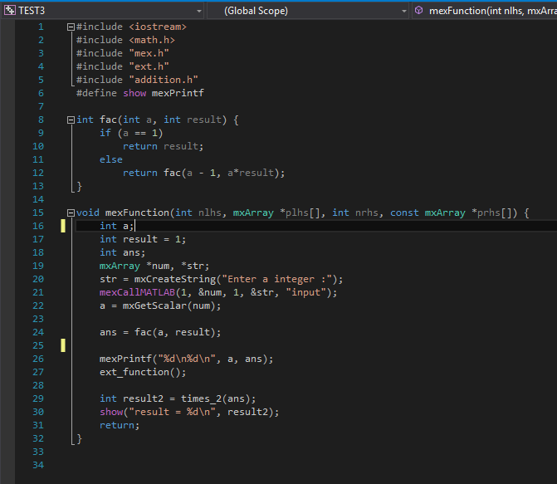
Step 3: Build mexFunction
Line 3 : mex.h (header file)
Line 15 : mexFunction(...)
- nlhs = number of expected output mxArrays
- *plhs = Array of pointers to the expected output mxArrays
- nrhs = Number of input mxArrays
- const mxArray *prhs[] = Array of pointers to the input mxArray
Line 15/19 : mxArray
- an identifier - built-in mex function
Built-in mex function
mxCreateString - initialized the mxArray to string argument
mexCallMATLAB - used to call MATLAB function, mex file, user-defined function
or even operator
- ‘sin’, ‘cos’, ‘+’,
mxGetScalar - get scalar/int of the mxArray
mexPrintf
Notes:
Testing

Slide 18
Step 4: Observe Built Solution in Visual Studio
Notes:
Testing

Slide 19
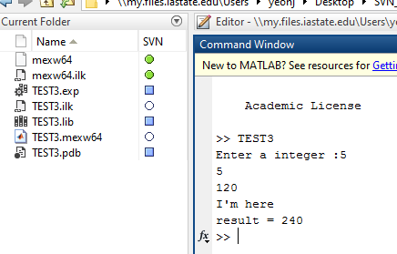
Step 5: Running Mex Function in Matlab
The mex function TEST3.mexw64 extension should appear in the output directory.
The mex function is ran in Matlab.
Notes:
Testing

Slide 20
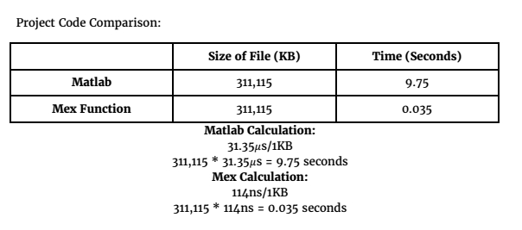
Matlab vs. Matlab Mex Function Efficiency

Slide 21
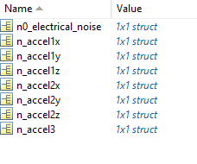
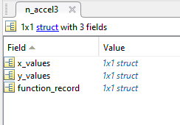
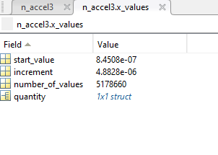
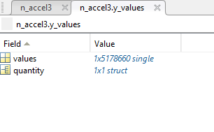
Engineering Analysis

Slide 22
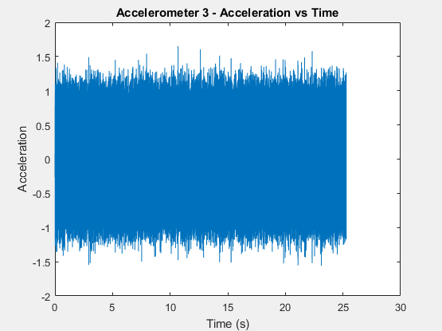
Engineering Analysis

Slide 23
A huge thank you to Dr. Zambreno for all his help and guidance
and to our client for this project opportunity!
QUESTIONS?

